Slide 1

Global Currency Issues:
Where are they, Why are they there and How you can prepare
Presented by: Fred Dons, Head of Structured Trade Finance
Aria Commodities
Date: June 11th, 2024
Session: # 33043

Slide 2
Today’s agenda
Me
A short recap
Where are we today
What is influencing the availability of foreign currency in a country
  The cost of oil
  Revised trade flows
  The effect of interest rates
Some of the hotspots, like Egypt, China, Japan and others
How to deal with currency issues, how to recognize and to prepare for it
  The canary in the coal mine, how to recognize potential issues
  How to limit them
  The importance of discipline

Slide 3
A bit about me - I was a banker for 35 years till I finally took the plunge and went over to the dark side and went corporate.
Today I’m the Head of Trade Finance at a mid-sized commodity trading firm and I’m finding our whether the lessons I gave over the years actually hold some value.

Slide 4
A short recap
2023 issues apart from some “historical” ones, where very much driven by the effects of the Russian invasion into Ukraine.
This drove up the prices of energy and caused a shift of major commodity flows from Europe to Asia and back
Countries which already had a weak economy, and which were recovering from the covid lockdowns were heavily effected and had to ration their foreign currency reserves. Even countries which had a relatively stronger economy were confronted with new currency flows.

Slide 5
Where are we today
The “world” seems to have found some form of equilibrium post
Russian invasion
Energy prices have somewhat normalized (especially gas/lng)
Flows have somewhat settled
“New” Crisis in the Middle East as a result cargoes around the cape
instead of Suez Canal.
The effect of countries trying/needing to avoid USD

Slide 6
Where are we today
  The “world” seems to have found some form of equilibrium post Russia invasion
  What does this mean?
  Flows have settled (with some consequences), historically oil and metal would flow from Russia to Europe, oil would flow from Saudi to Asia
  This has now reversed and has, amongst others, had its effect on availability of foreign currencies
  We have “new” crisis in the Middle East is (cargoes around the cape instead of Suez Canal)

Slide 7
What is influencing the availability of foreign currencies today
Those who have listened to one of my presentations before will know I will rarely discuss the actual currency or its exchange rate. I focus more on why certain things are happening in a certain way, so that you can perhaps better prepare yourself for potential issues.
The actual cost of energy for a lot of countries. In order to sustain their economy, the oil price needs to be at a certain level
The revised trade flows
Inflation has calmed down a bit, but it is not far away

Slide 8
The Cost of Oil
Why some oil producing countries are “struggling
Saudi Arabia USD 10 to produce 1 barrel
                Breakeven point USD 108
Russia USD 15 to produce 1 barrel
                Breakeven point USD 114
Nigeria USD 48 to produce 1 barrel
                Breakeven point USD 60
Iran USD 15 to produce 1 barrel
                Breakeven point USD 112
USA USD 28 to produce 1 barrel
                USD 38 for existing wells, USD 62 for new drilling
Venezuela USD 28 produce to 1 barrel
                Breakeven USD 57

Slide 9
Revised trade flows
The invasion into Ukraine and the follow up sanctions resulted in some major and essential commodity flows having to be redirected
  Oil from Russia now flows to Asia
  Same for metal
  Oil from Saudi now flows to Europe and the US has become a big supplier of LNG to Europe
As USD is no longer a currency for goods with a Russian origin, this has also caused a major shift in trade currencies and a lack of USD for some countries

Slide 10
Interest Rates
The Western world is eagerly awaiting a lowering of interest rates so that they can go back to borrowing
This is probably the reason why central banks are holding off on lowering these rates right now, as we can easily go back to the inflation rates we had 2 years ago
A number of countries have ballooned their debt. At some point, all of their available foreign currency reserve will have to be applied to servicing their debt
A lower interest will help these countries on the short term. However, if they do not get their house in order after refinancing a default will become inevitable.

Slide 11
Some of the hotspots
India
Egypt
“the Middle East”
Turkey
Argentina
China
Japan
Venezuela
Honduras

Slide 12
India
Elections this year
Disparity on economic growth. A large group of young people do not participate in this growth
Was able to become a kingpin between Russia and the West. Is stuck with a lot of Rubbles and we still see currency shortage for everything not energy related.
On March 29th, India unveiled its new foreign trade policy, which allows the use of rupees in trade with countries facing dollar shortages or currency crises. Malaysia is the latest country to join this scheme. The Reserve Bank of India (RBI), India’s central bank, had already decided in July 2022 to allow international trade to be settled in rupees. This move was intended to boost global trade and support the interests of traders who use rupees. India already trades in rupees with Russia, Mauritius, Iran, and Sri Lanka. https://moderndiplomacy.eu/2023/04/30/india-joins-china-in-de-dollarization-drive/

Slide 13
Egypt
The good news:
  IMF has extended its loan by USD 5 billion to USD 8 Billion on the condition that the Egyptian pound will be let to float, making exports more attractive (but imports more expensive)
  Both the UAE and Saudi Arabia have made significant investments into Egypt (24 billion and 11 billion respectively)
  This has provided the Egyptian government for sufficient foreign cash at hand for now
The bad news:
  The interest went up with 600 points
  Poverty has gone up as purchasing power has gone down
  The “vanity project” new city capital only increases the government debt
  Less use of the Suez canal effects income negatively.

Slide 14
Situation in Middle East
Attacks on commercial vessels trying to go through the Suez Canal
Uncertainty in Strait of Hormuz
Effect on the oil price (and subsequent effect on the currencies for those countries dependent on import of oil) , freight charges will be affected, cargoes do take much longer and this does affect the supply chain.

Slide 15
Turkey
Inflation is back up to 70 % caused mainly by increased consumer spending and an increase of the minimum wage
Exchange rate of the USD is now 32 Lira for a dollar and for Euro it is 34 (in 2006 this was 1,34 and 1,88 respectively)
Interest rates went from 8.5 % around the previous elections to 50 % today following a more tighter regime of the central bank. Erdogan has stated he will not be up for re-election.
The country did experience a positive economic growth of 4.5%, but investors are cautious to come back and want to see a continuing strict regime on the economy

Slide 16
Argentina
Shock therapy – Javier Milei hit the ground running. However, he has met strong opposition in parliament. Milei holds only 38 of the total 257 seats and he tried to rule by decree.
The majority of his shock therapy has been reversed by the courts in the meantime. His hope is now set on the 2025 elections, hoping to gain a bigger share of the votes
Year on Year Inflation is up from 143 % to 257% in February due to the devaluation of the peso. He did manage to balance his budget, but this was the result of cutting a lot of subsidies. This could hinder success in the next election.
Milei is continuing to devalue the peso to bring it in line with the “unofficial” exchange rate. In the longer run this should make Argentina’s exports cheaper and make it more interesting for investors. In the short run inflation goes up even further (almost 300% year on year at this moment)
Normally, when inflation goes up the Central Bank will increase the interest rate. However, in the case of Argentina, the Central Bank could not afford it due the very popular short term “quasi” bonds for which it would have to pay out much more interest. This pay out would drive up the inflation due to the influx of more money into the economy

Slide 17
China
Inflation close to zero, even deflation for some months
Economic growth around 5 %
Exchange 1 to 7.25 (USD/RMB)
Growth for now but more difficult times ahead due to strained relations with its main trading partners, real estate sector defaults, weak consumer spending, aging population, disparity wealth

Slide 18
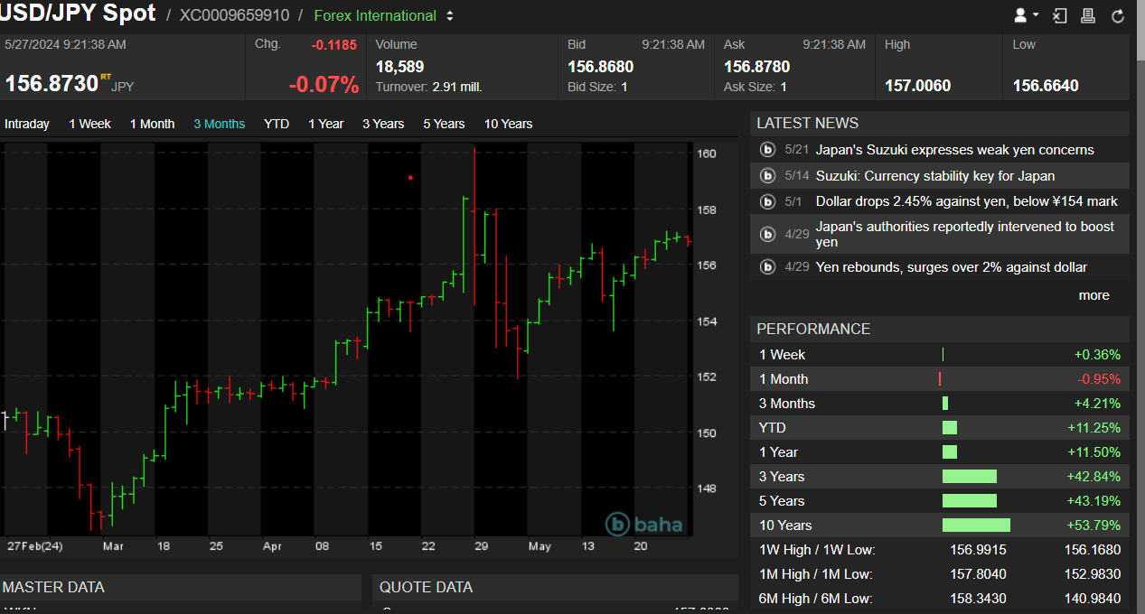
Japan
After decades of stagflation, Japan is now “enjoying” inflation
The weaker yen has caused an influx of investors, mainly from China and has made exports cheaper for the country.
The relatively low energy prices help to counter the lower yen effect

Slide 19
Venezuela
Inflation 250 %
Although some of the sanctions are lifted, no regular business possible. This is also due to alignment with Russia

Slide 20
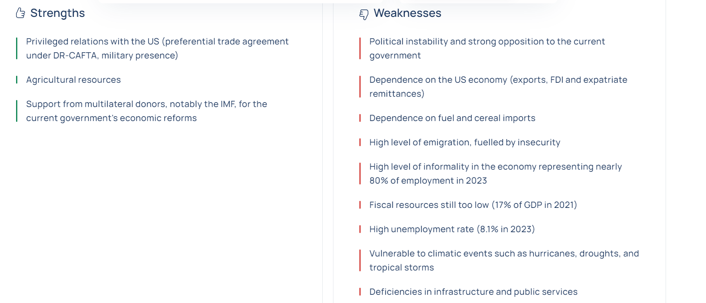
Honduras
From the Coface website:

Slide 21
What can/should you do
Discipline
Be prepared
Price the risk appropriately
Be prepared to step away

Slide 22
Discipline
The only way you are “guaranteed” payment in USD (or Euro for that matter) is to get paid through a confirmed letter of credit
If you contractually agreed to receive an LC issued and confirmed by a bank acceptable to you, do not agree to ship until all conditions are met .. in writing ..through your bank.
Please note that, although contractually agreed between you and the contracting party, issuing banks have a tendency to “forget” to ask for confirmation
It is quite easy to create an LC which contains traps. Have your checklist ready, work with pre agreed templates, and double check the L/C before releasing any shipment.

Slide 23
Be prepared
Have an idea of the local interest rates of your counterpart
Know what local currency issues are
Know how to price this risk
Talk to your bank on what they can do to mitigate these risks and make sure these mitigations are priced into your product.
Have a contract and an LC template at hand. It is ok to negotiate and to deviate, but first have something from which you can actually deviate

Slide 24
Pricing the risk
If you know the local financing cost of your counterpart and when you know what it will cost you to get any deferred payment discounted by your bank, you know how much room you have to negotiate.
The cost of your product should consist not only of the pure manufacturing cost but also your financing costs. This should increase with the risk premium of doing business with the counterpart.
Know what these cost actually are and see at what place in the transaction is it most efficient to pay them (sometimes it is cheaper when you pay these costs and integrate them in your cost price)
If you accept not having a perfect payment instrument, know how much you can afford to lose and price this into your sale

Slide 25
Be prepared to step away
We know the sunken cost fallacy, but can you actually afford to lose a full shipment?
We saw in both Egypt and Pakistan that goods were released and payment was postponed indefinitely.
Can you afford a 6 month (or more) payment delay ?
If you agree to a payment by LC, make sure you can actually meet its conditions. Otherwise, you are just creating a false sense of safety and throwing away good money after bad.
Any amendment under an LC needs to be in writing and confirmed by your bank. Your client promising to accept discrepancies is really of no value.
If your conditions are not met, the best case scenario is you losing a few days of interest. The worst case is losing the principal amount.

